Slide 1
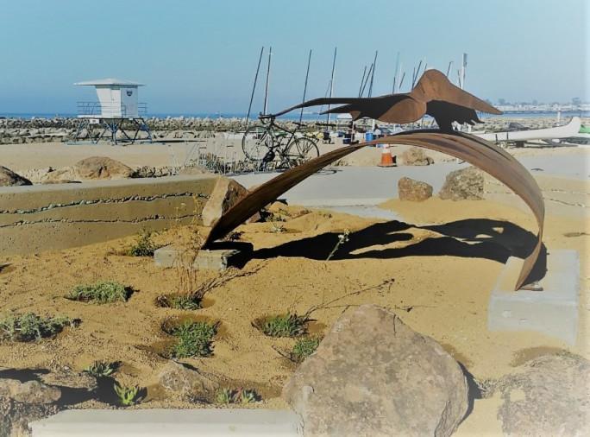
NEW YEAR, NEW PROGRAM, NEW NAME
Live Oak Parking Program 2021
February 3, 2021, 6pm

Slide 2
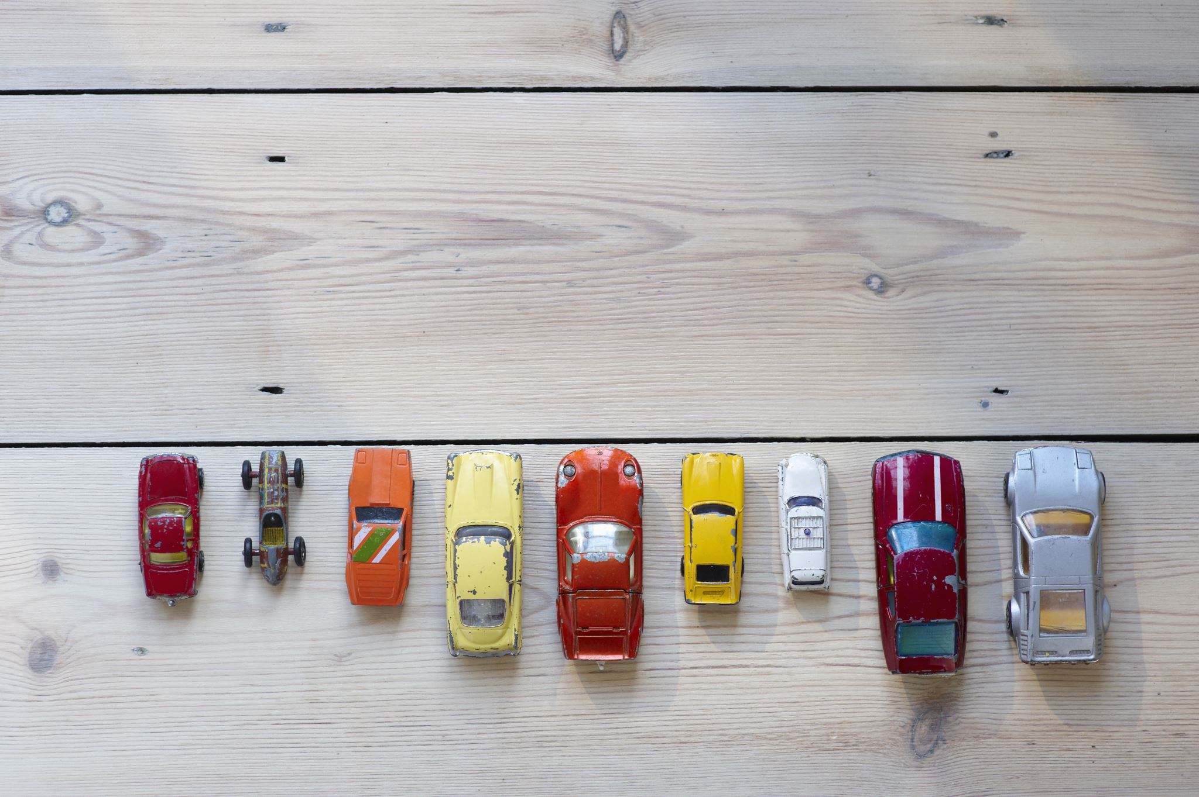
Agenda
Current LOPP Program (5 min.)
  History of the Program
  Purpose of the Program
Proposed Improvements (20 min.)
  Improve Coastal Access
  Parking Organization
  Clearer Signage and Boundaries
  Additional Enforcement
  Potential Program Expansion
Community Polling (5 min)
Public Comments by Program Feature (60 min)
Questions and Answers if time permits

Slide 3
THE PURPOSE AND HISTORY OF THE LIVE OAK PARKING PROGRAM
The Live Oak Parking Program was first introduced during the 1979/1980 fiscal year as a parking permit and beach transit program. The intention of the program was to reduce traffic and parking during peak beach use and to encourage and enhance beach access by way of a park and ride system originating from outside the Live Oak Parking zone.
In 1981, the program became a ‘permit parking’ program. Over the next ten years, a majority of the zone was defined by the addition of many ‘beach access’ streets. Today, any significant changes to the program or additions of streets into the zone must be approved by the California Coastal Commission.
The current program purpose is to provide organized access to the beach for residents and visitors.

Slide 4
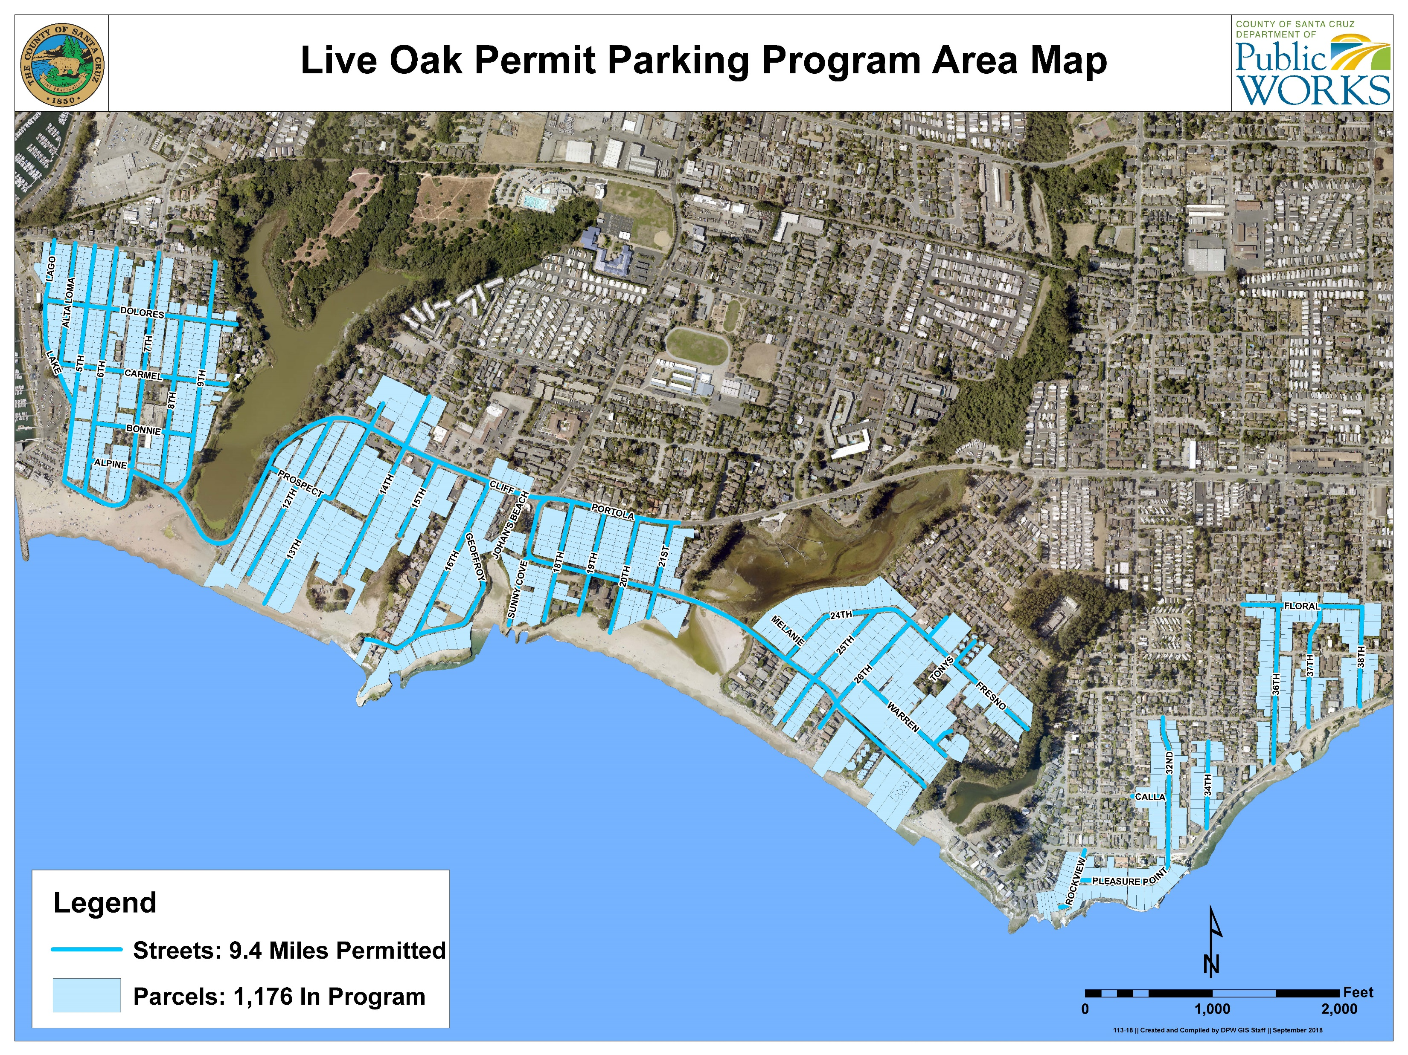

Slide 5

  COASTAL COMMISSION PRIORITIES
  Improve accessibility for all to the beaches
  Affordability – First hour free
  A county wide program
  Name change and rebranding of LOPP

Slide 6
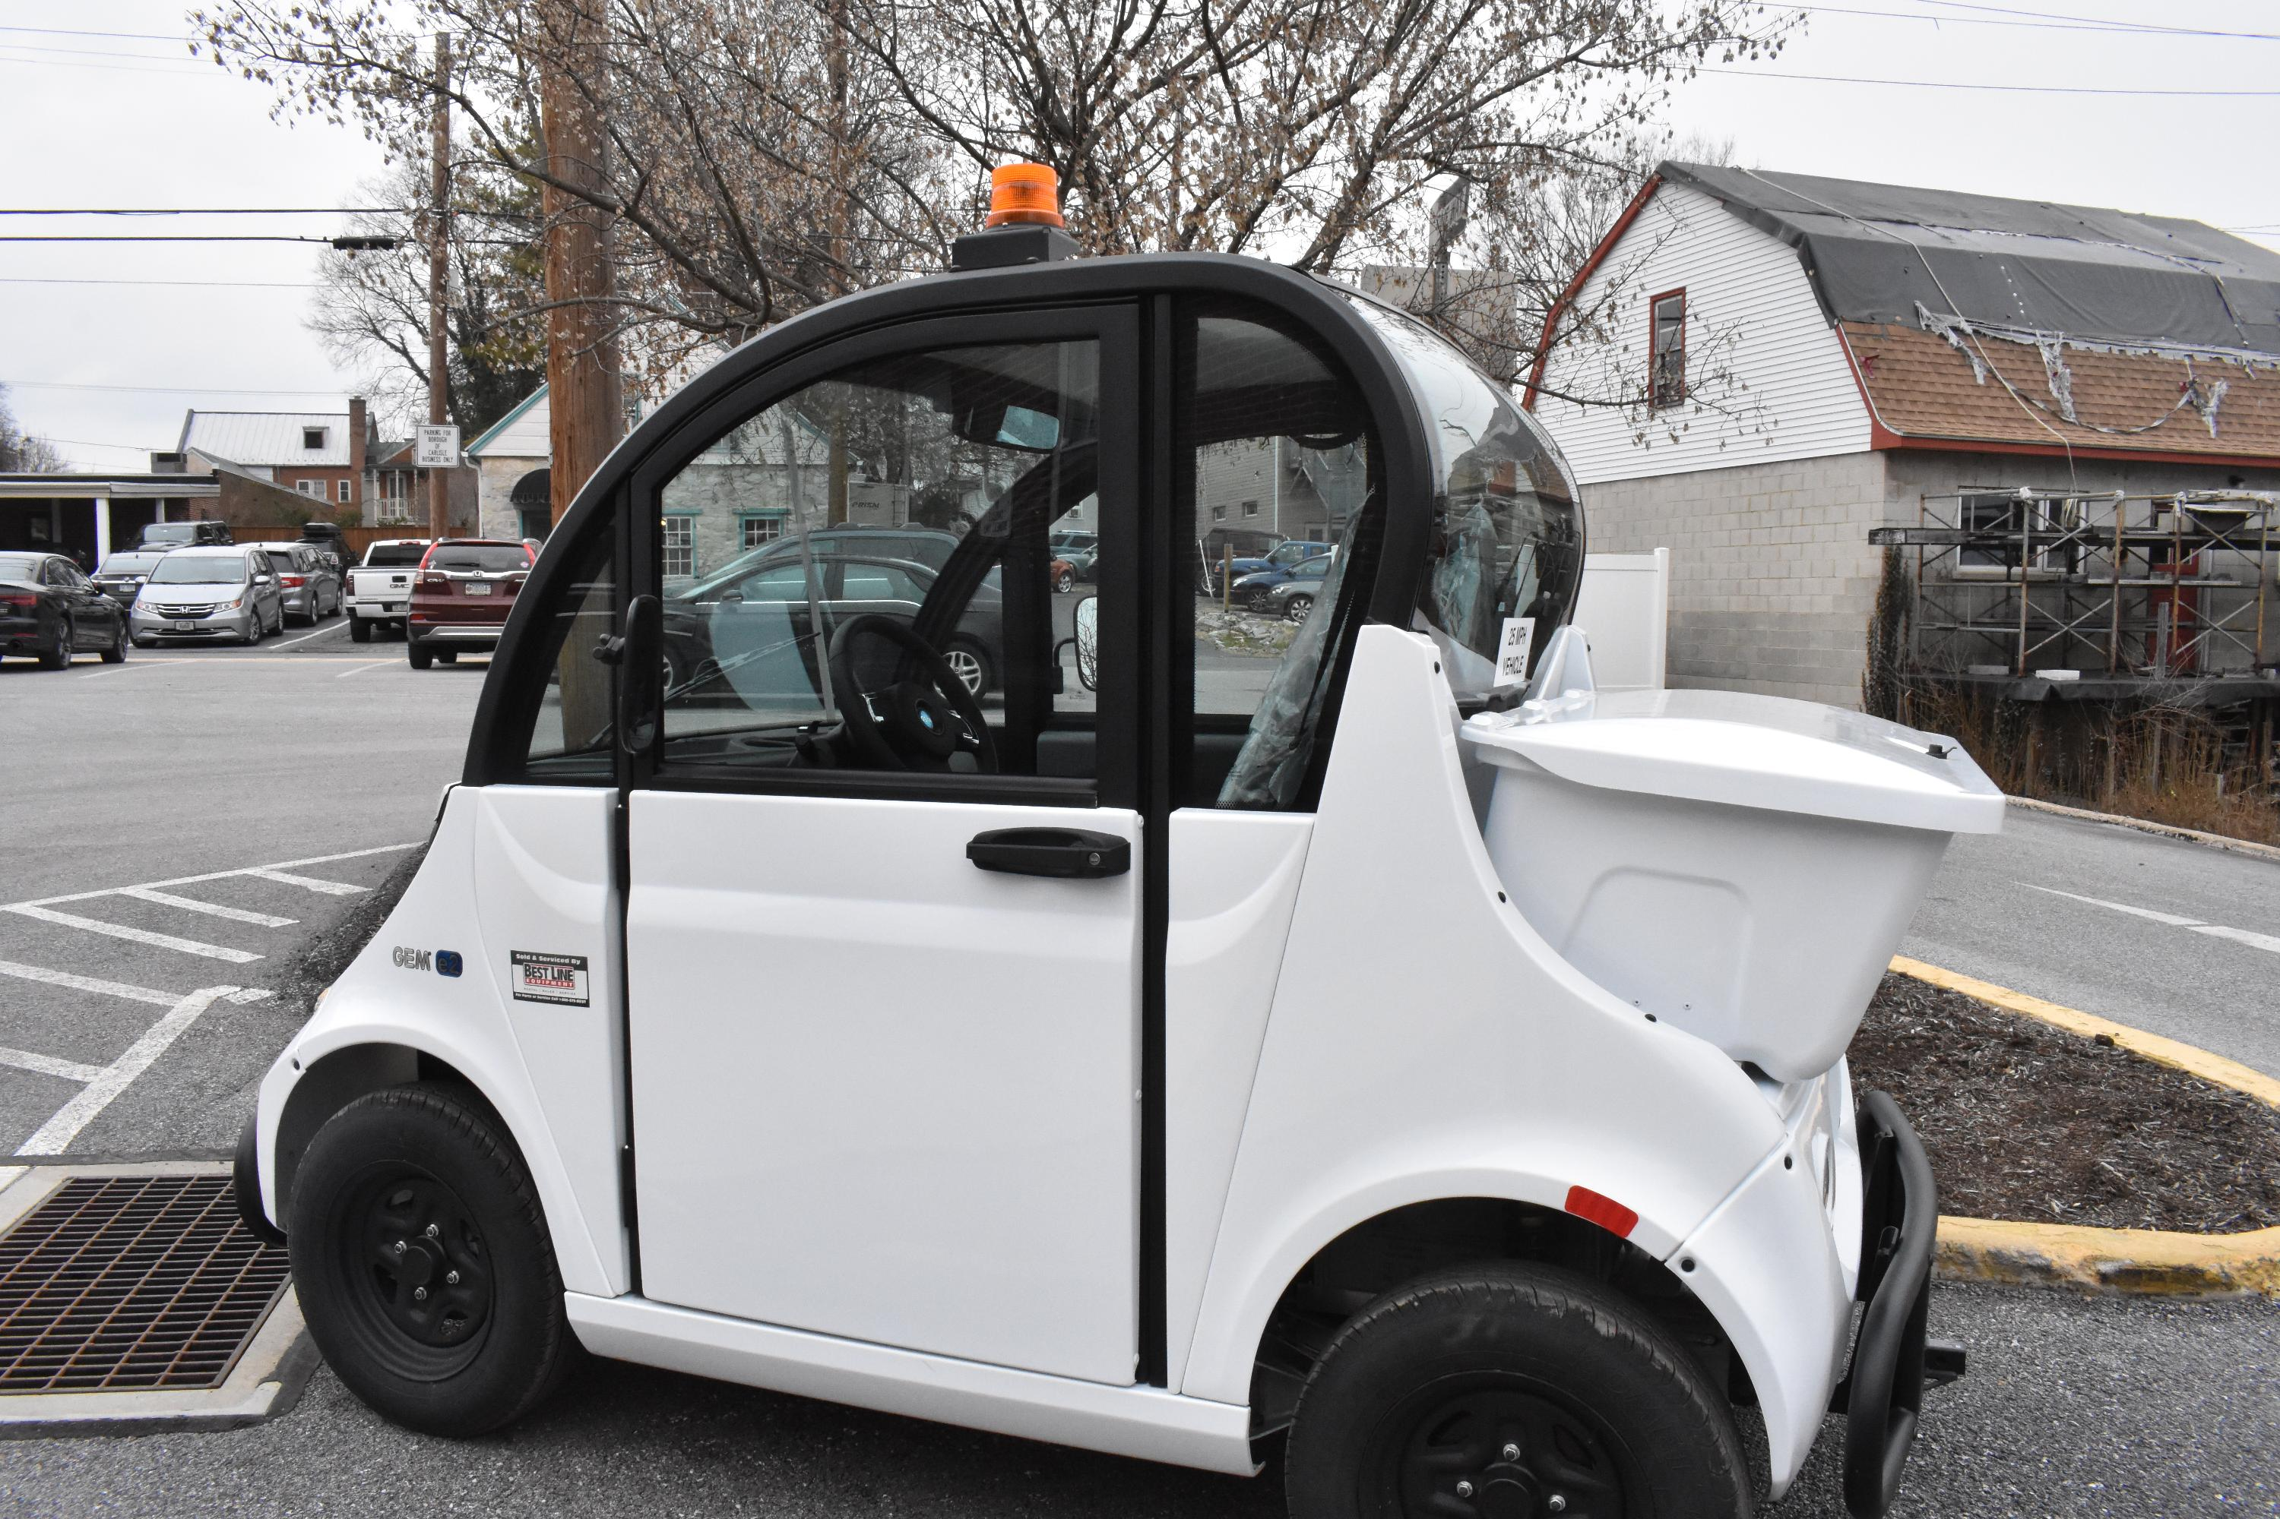
  RESIDENT PRIORITIES
  Improved enforcement
  Year-round program
  Better signage
  Improved coastal access
  Expanded program area
  Digital based parking App
COUNTY OF SANTA CRUZ
PARKING PROGRAM

Slide 8
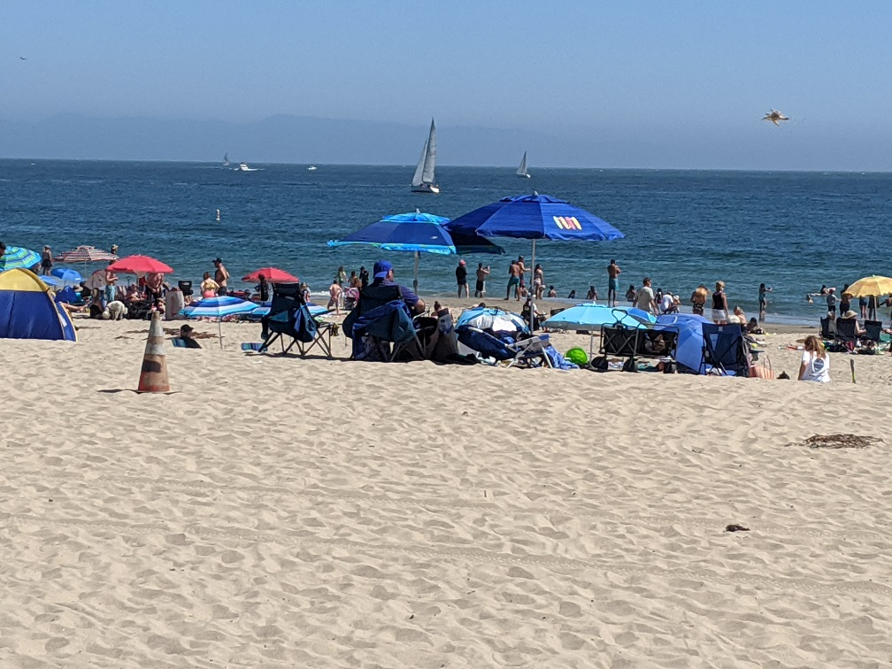
PROPOSED CHANGES FOR 2021
Implement Parking App –mobile/desktop
Introduce hourly parking fees in lieu of daily pass
Annual Permit $100 - same cost for residents and visitors
New Signage
Twin Lakes Beach 2020

Slide 9

SANTA CRUZ COUNTY
  Changes for the Future
    Expand LOPP Boundaries
    Year-round program
    One annual permit for residents & visitors
    Expand program county wide (North coast and South coast)
    Organized parking

Slide 10
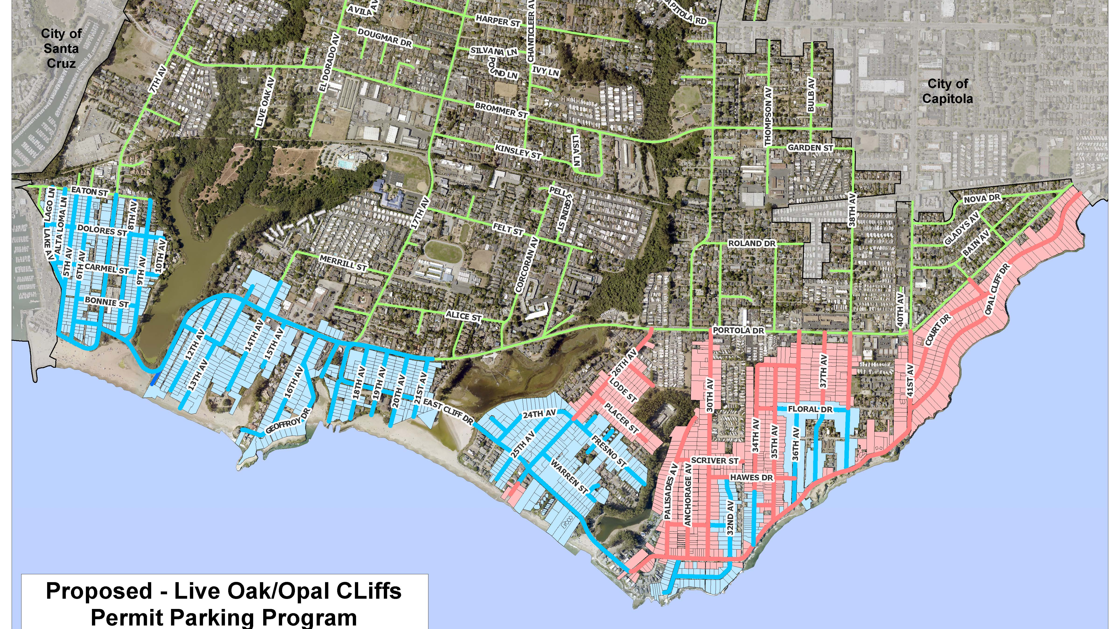

Slide 11
Timeline and Next Steps
Place Polling Survey on LOPP Website- available for one week
  https://www.dpw.co.santa-cruz.ca.us/Home/ParkingPrograms/LiveOakParkingProgram.aspx
Second Zoom Meeting February 17th, 6pm
  County to share proposal based on polling and community input.
Coastal Permit to be submitted by March 1, 2021
Board of Supervisors April 13, 2021
Program new season begins May 1, 2021

